Slide 1
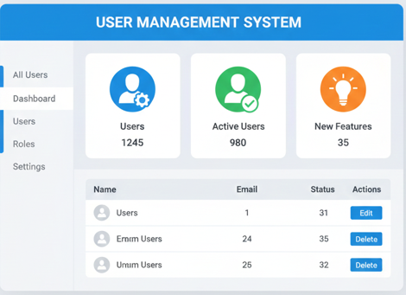

Slide 2
Simple User Management
Implemented using AI (Google Gemini)
100% development done using AI
Application requirement (SRS) auto generated
Mind map auto generated
100% Postman collection generated
90% Automation code generate (some tweaks)
Solution based on Docker
Programming done using Python, DB is SQLite

